Slide 1
Tutorial 1: Alignments
Comparing MUSCLE and MAFFT Alignments

Slide 2


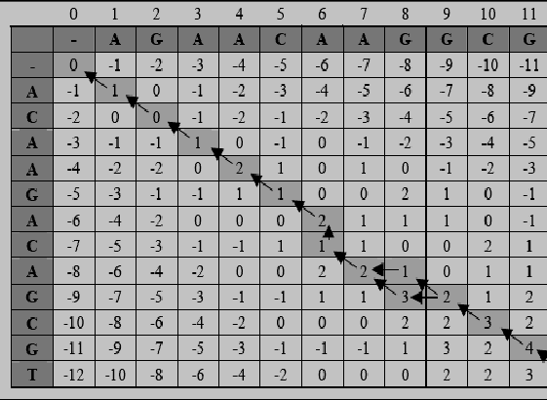

What is Alignment?
TREE VS. REED
TREE
REED
TREE_
_REED

Slide 3
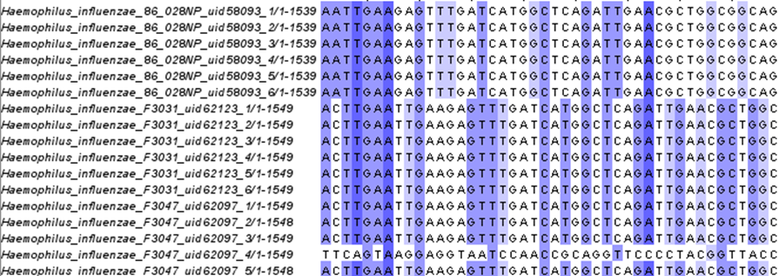
Before Alignment

Slide 4
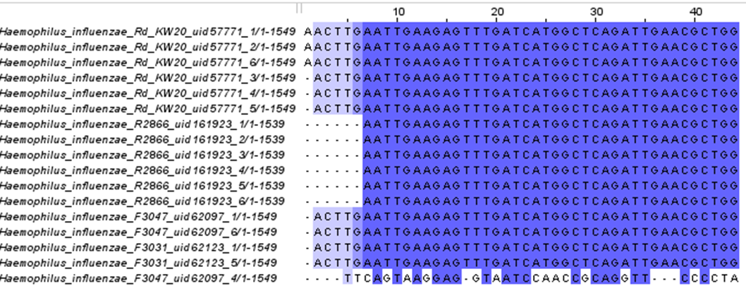
After Alignment

Slide 5
16S rRNA Sequence
Commonly used Gene sequence of a prokaryotic cell
Used to characterize/identify sample bacteria and archaea
Small frequency size makes the data limited, but efficient

Slide 6
The Assignment
Extract and align influenza strains found in 16S rRNA Sequence
MAFFT – Multiple Alignment Fast Fourier Transform
MUSCLE – Multiple Sequence Alignment by log expectation

Slide 7
MUSCLE/MAFFT Alignment
Three alignment strategies
Progressive method (1).
The iterative refinement method with the WSP score (2).
The iterative refinement method with both the WSP and consistency scores (3).
For speed:
1 > 2 > 3
For accuracy:
3 > 2 > 1

Slide 8
Progressive Method
Can handle up to 5000 sequences on a standard desktop computer
Method | Sum of Pairs Score (SP) | Total Column Score (TC) | CPU Time (s)
MAFFT FFT-NS-1 | 79.63 | 42.00 | 140
MAFFT FFT-NS-2 | 79.88 | 44.01 | 250
MUSCLE 3.52 | 77.63 | 39.71 | 160
* Full-length sequences

Slide 9
Progressive Method/FFT-NS-1
The simplest progressive option.
One of the fastest methods currently available.
Procedure:
Make a rough distance matrix by counting the number of shared 6-tuples between every sequence pair.
Build a guide tree.
Align the sequences according to the branching order.

Slide 10
Progressive Method/FFT-NS-2
The distance matrix for FFT-NS-1 is very approximate and unreliable
Procedure:
Make a rough distance matrix by counting the number of shared 6-tuples between every sequence pair.
Build a guide tree.
Align the sequences according to the branching order.
Recomputes the guide tree.
Align the sequences.

Slide 11
The iterative refinement method with the WSP score
Accuracy of the alignment can be improved at the cost of speed
Method | Sum of Pairs Score (SP) | Total Column Score (TC) | CPU Time (s)
FFT-NS-i | 82.95 | 50.97 | 2800
MUSCLE 3.52 | 81.67 | 46.79 | 3400
* Full-length sequences

Slide 12
The iterative refinement method with the WSP score FFT-NS-i
Procedure:
Make a distance matrix by counting the number of shared 6-tuples between every sequence pair.
Build a guide tree.
Align the sequences according to the branching order.
Recomputes the guide tree.
Align the sequences.
Iterative refinement (WSP)

Slide 13
The iterative refinement method with both the WSP and consistency scores
Combines WSP score and consistency score to obtain more accurate alignments.
Method | Sum of Pairs Score (SP) | Total Column Score (TC) | CPU Time (s)
L-INS-i | 87.05 | 58.64 | 5500
E-INS-i | 86.91 | 58.55 | 6000
G-INS-i | 84.23 | 52.64 | 6900
* Full-length sequences

Slide 14
The iterative refinement method with both the WSP and consistency scores
Procedure:
Make a distance matrix by counting the number of shared 6-tuples between every sequence pair.
Build a guide tree.
Align the sequences according to the branching order.
Recomputes the guide tree.
Align the sequences.
Iterative refinement (WSP) and consistency scores.

Slide 15
MUSCLE
Iterative Method to align and score sequences
Log – Expectation is used to create a global score as multiple sequences are aligned
log(E[X])
Pairwise Sequence between pairs -> Score Created -> Log Expecation to simplify global score
Simple/Efficient, good for smaller sequences

Slide 16


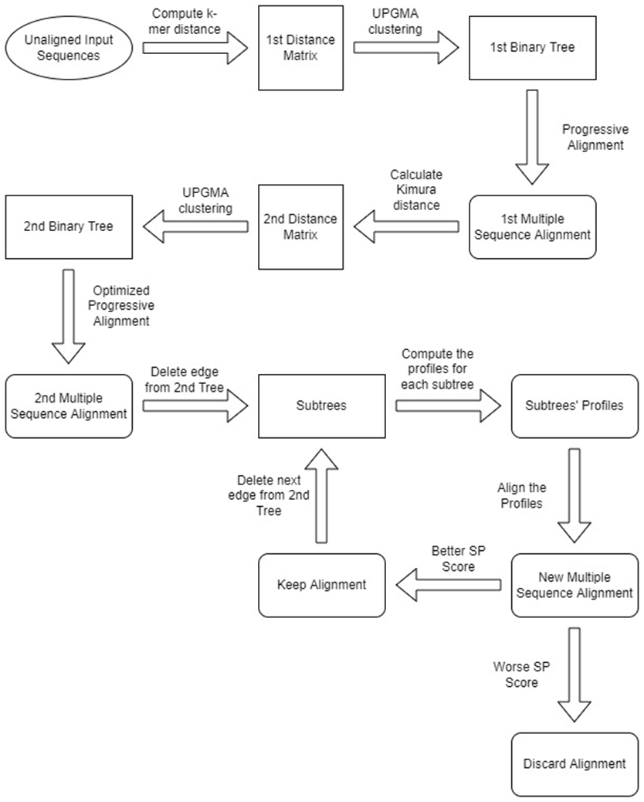

Muscle Alignment

Slide 17
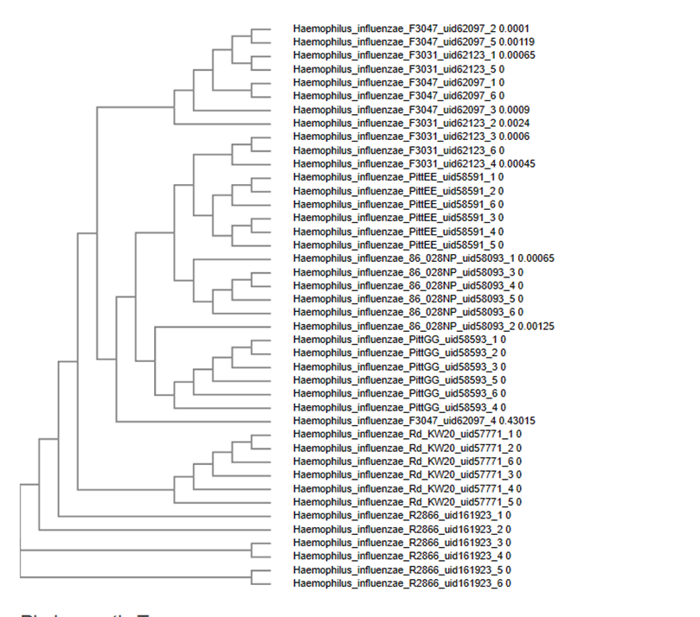
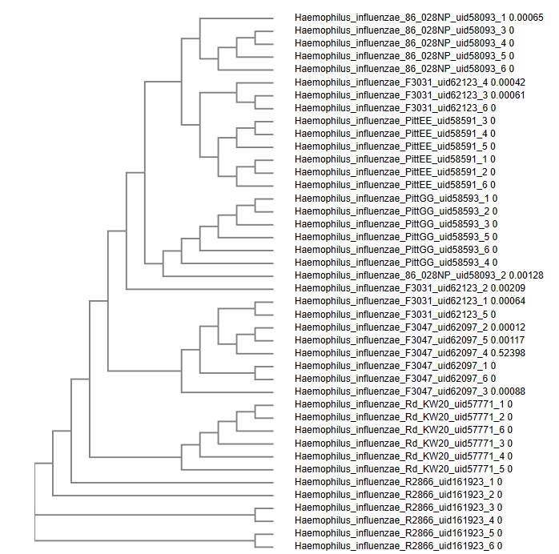
Results MUSCLE vs MAFFT
MUSCLE
MAFFT

Slide 18
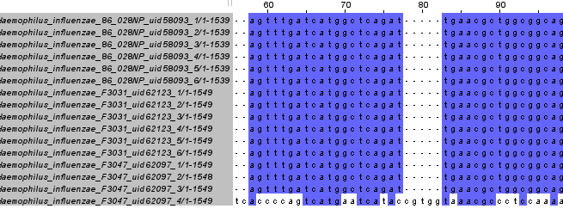
MUSCLE VS MAFFT
MUSCLE
MAFFT

Slide 19
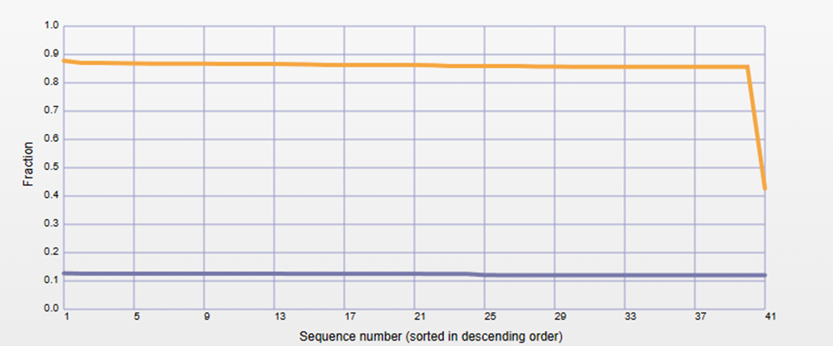
Conclusion
Similar Results at this size
MUSCLE computed with less CPU power, and slightly faster
In theory MAFFT is more accurate for larger sequence pools

Slide 20
Using CIPRES Tutorial
Cyberinfrastructure for Phylogenetic Research
Provides a simple browser interface
Community code run on large computational resources
Navigate to phylo.org and create an account
1000 hours of compute time free

Slide 21
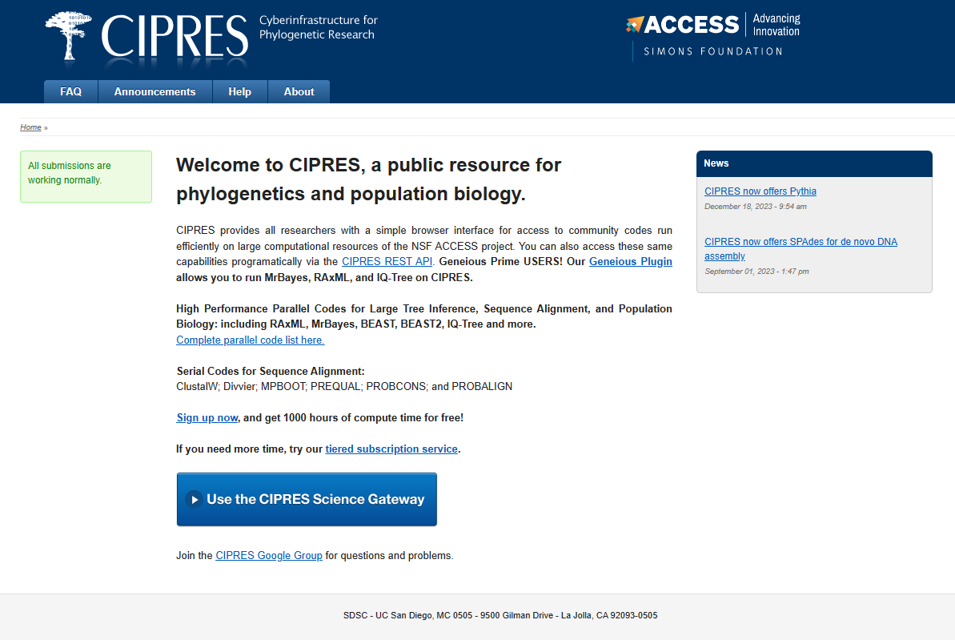
Using CIPRES Tutorial
Select Use the CIPRES Science Gateway

Slide 22
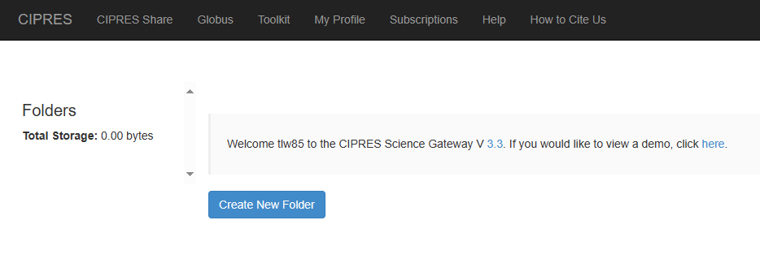
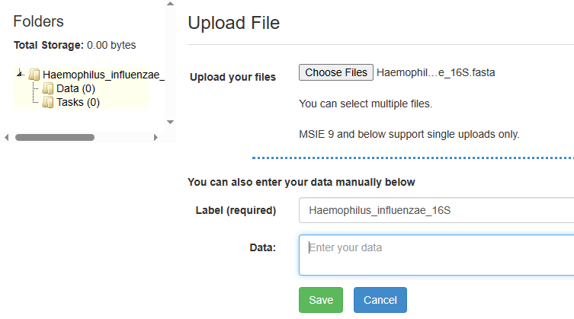
Using CIPRES Tutorial
Create a New Folder
Choose File to Upload
Enter Label Name
Click Save

Slide 23
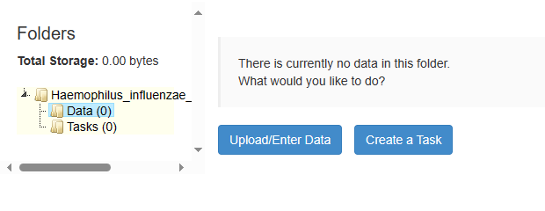
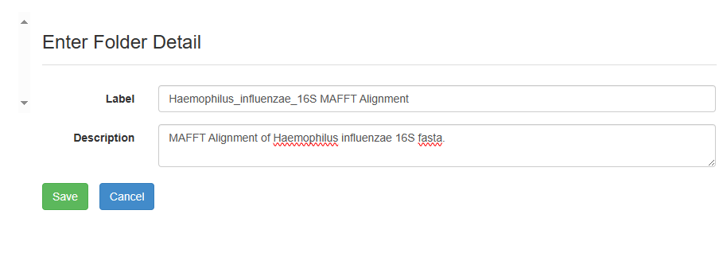
Using CIPRES Tutorial
Select Data
Select Upload/Enter Data
Enter Label and Description
Click Save

Slide 24
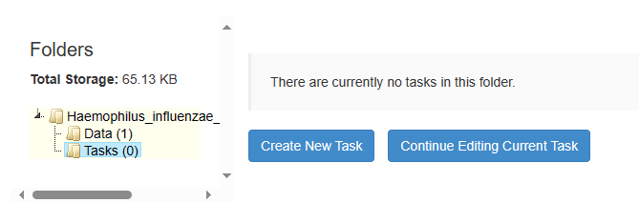
Using CIPRES Tutorial
Select Tasks
Select Create New Task

Slide 25
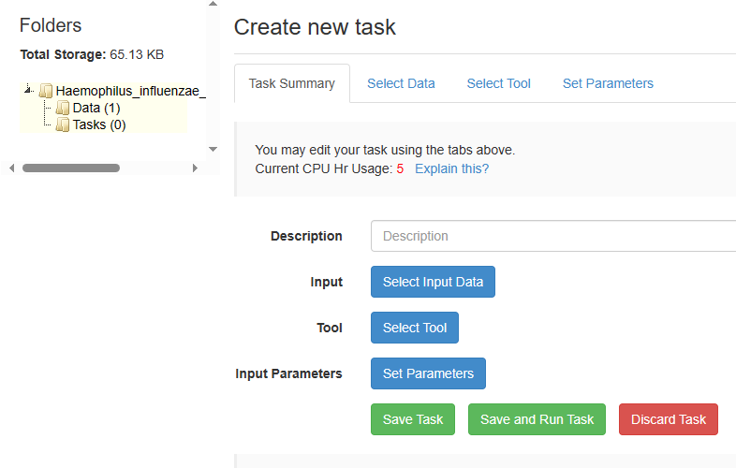
Using CIPRES Tutorial
Select Input Data
Select Alignment Tool
Set Parameters
Click Save and Run Task

Slide 26
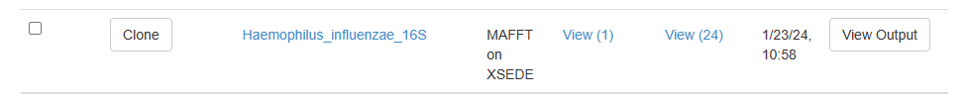
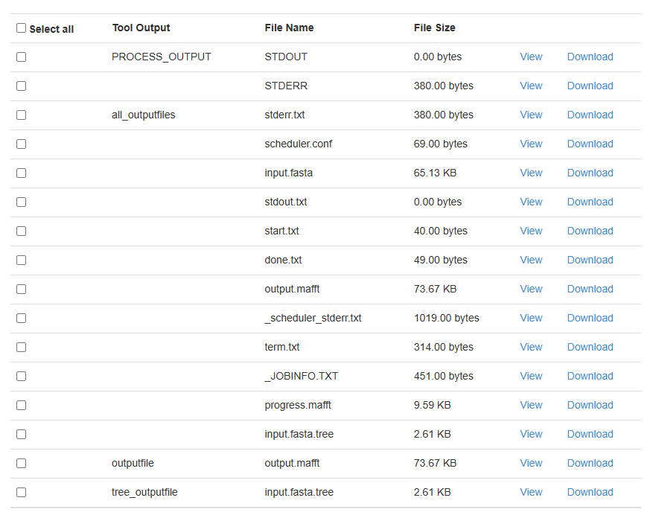
Using CIPRES Tutorial
View Output
Output

Slide 27
References
CIPRES Science Gateway | Home (phylo.org)
Simple Phylogenetic Tree < Phylogeny < EMBL-EBI
MView < Multiple Sequence Alignment < EMBL-EBI
https://www.jalview.org/

